Slide 1

5. Differential Expression Analysis in scRNAseq
Jose Alejandro Romero Herrera
Data Scientist

Slide 2
Agenda. Postprocessing
Quality control
Dimensionality reduction and Visualization
R language-Seurat
Clustering
Batch correction
DEG analysis
GREAT, PANTHER, GOrilla, DAVID
GO-term and pathway analysis
Diffusion maps/Slingshot
Pseudotime
Notes:
Glossary of single cell terms: https://nbisweden.github.io/single-cell-pbl/glossary_of_terms_single_cell.html
R language: https://www.r-project.org/ https://rstudio.com/
Seurat: https://satijalab.org/seurat/
GREAT: http://great.stanford.edu/public/html/
PANTHER: http://www.pantherdb.org/
GOrilla: http://cbl-gorilla.cs.technion.ac.il/
DAVID: https://david.ncifcrf.gov/
Diffusion maps: https://www.sciencedirect.com/science/article/pii/S1063520306000546
Slingshot: https://bmcgenomics.biomedcentral.com/articles/10.1186/s12864-018-4772-0

Slide 3
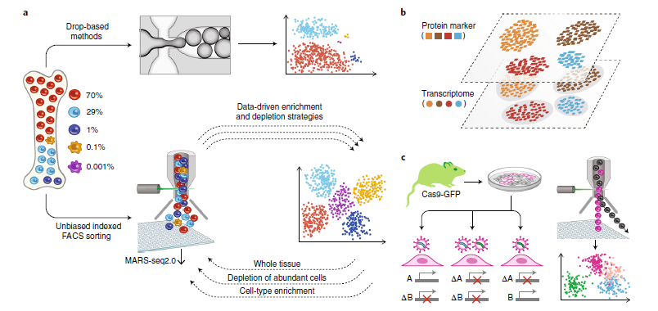
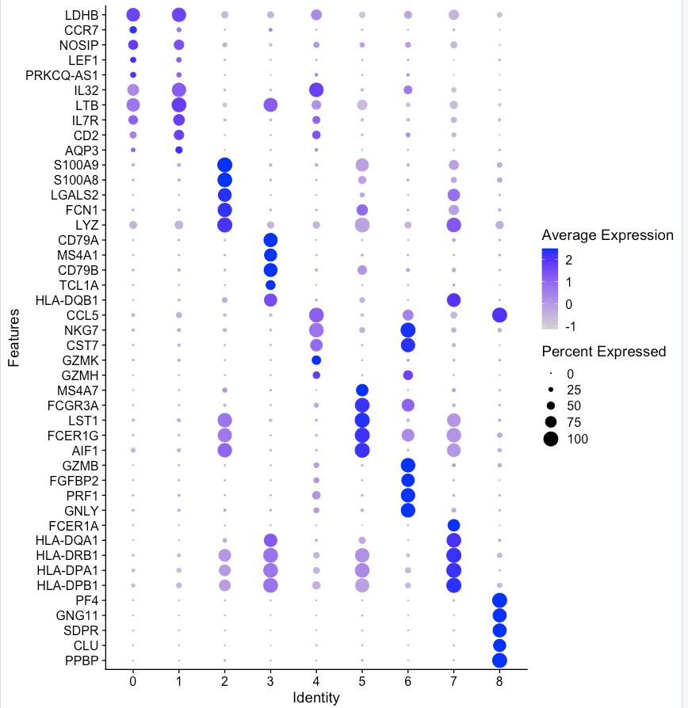
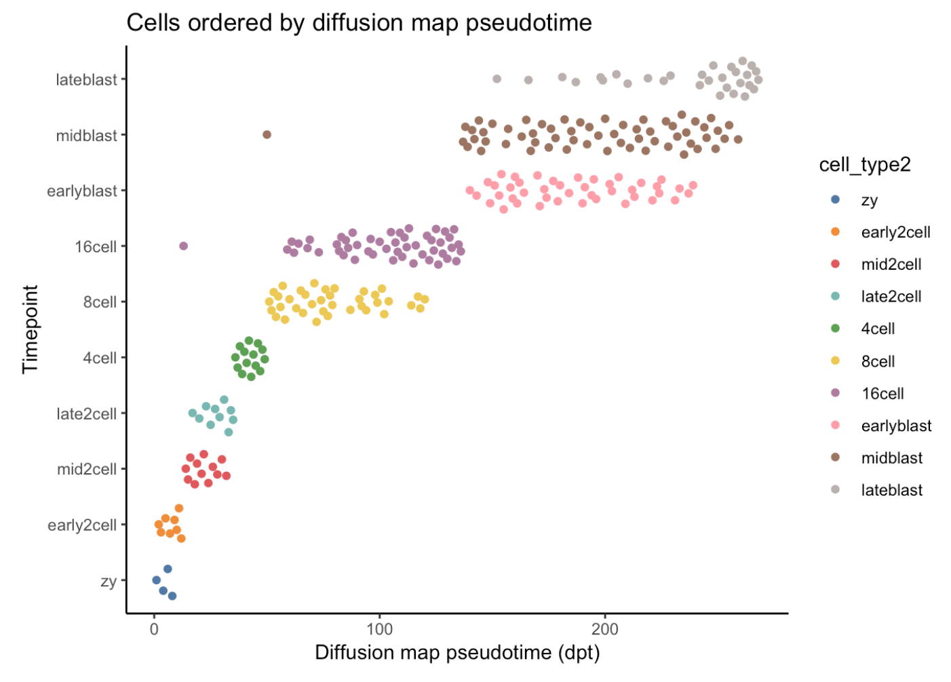
Workflow
Batch correction
QC
SC experiment
DE
Enrichment analysis
Clustering
Dimensionality reduction
Visualization
Pseudotime

Slide 4
Differential Gene Expression Analysis
Comparison between conditions or clusters
As for bulk RNAseq, Log₂ Fold Changes and p-values are calculated
Statistical testing is a bit different than for bulk RNAseq (Wald test)
Common test is Wilcoxon test (Mann Whitney)
It is possible to produce a list of ”markers” per condition or cluster
Markers and their expression can be visualized in different ways
Clusters can be annotated based on their markers with previous knowledge

Slide 5
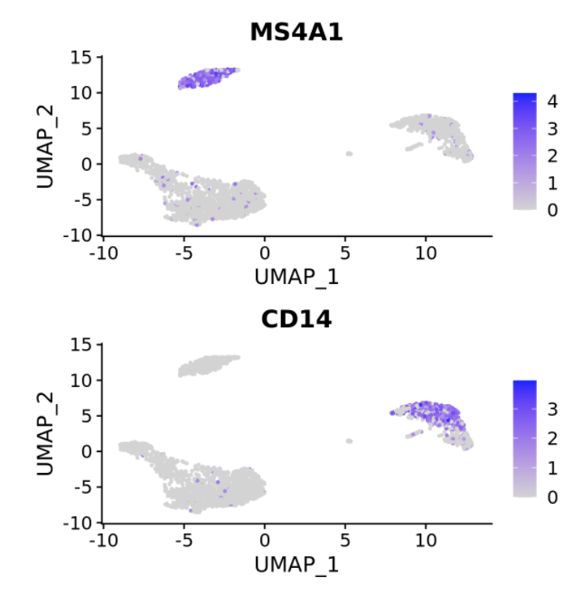
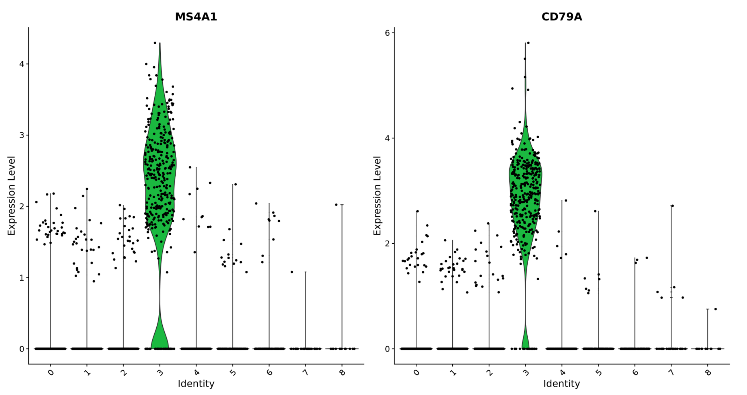
Differential Gene Expression Analysis
Dropouts!

Slide 6
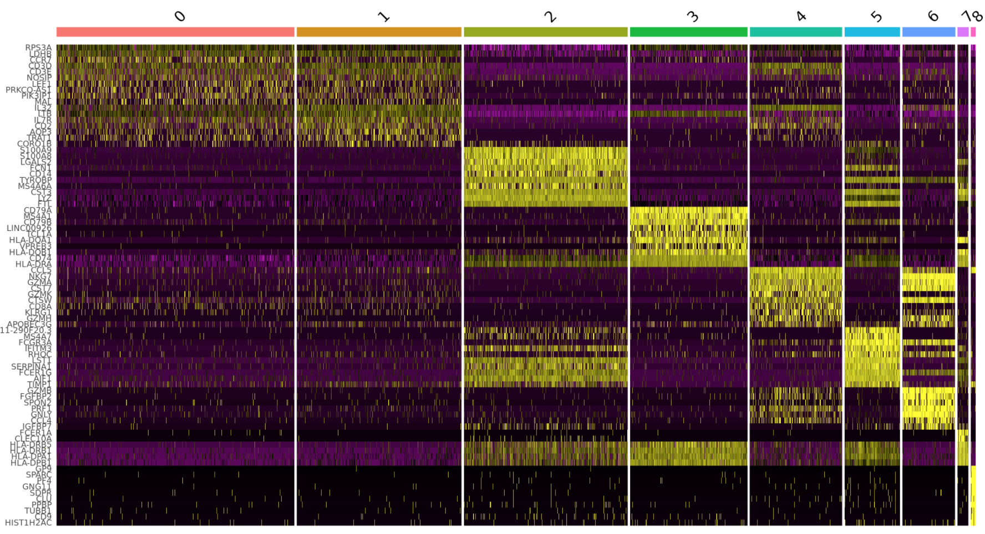
Differential Gene Expression Analysis

